Slide 1
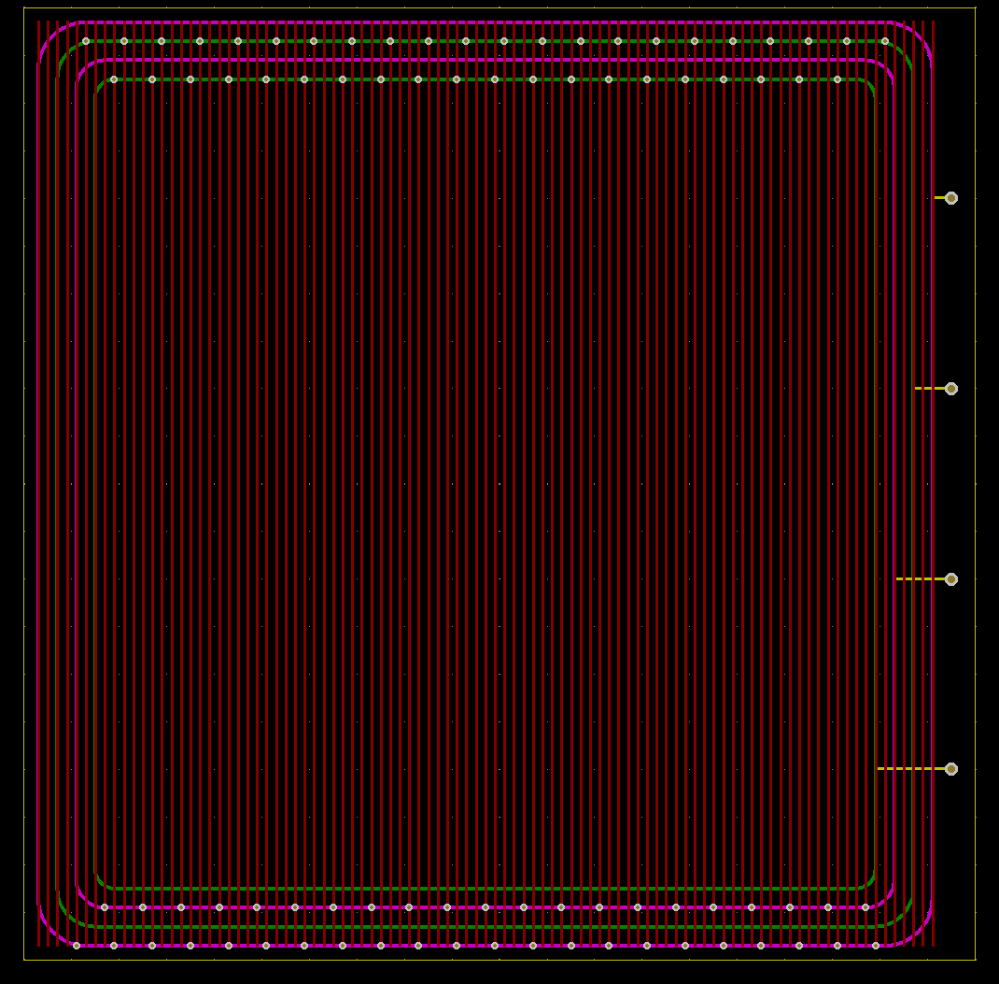
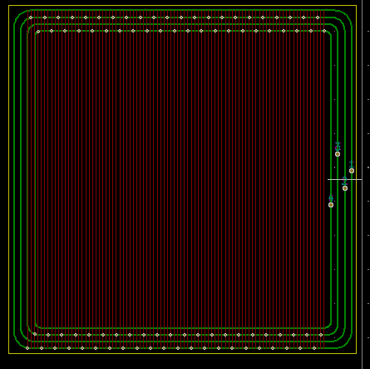




ELECTRICAL
EDS DESIGN
Amrita, Jules, and Hope
04/16/21
Ordered Test PCBs!
Next Steps:
Contact manufacturers for next designs
Make sure everything is ready for testing

Slide 2
ELECTRICAL
DCDC Converter in Panel
Amrita Mayavaram
04/16/21
Pros:
Simplifies selection of connectors (would no longer need to be high voltage)
The switching mechanism may need to be in the panel regardless since I don’t think it will be possible to fit 7 hv connectors into the finger joint
HV connectors require making the panel thicker as well
Removes issue of capacitance causing high currents
Cons:
Could potentially interfere with EDS in panel
Could require some sort of thermal management system in panel depending on efficiency and current
Would require panels to be thicker
Smallest converter available is 12.7 mm tall, exploring possibility of custom one that is thinner

